Slide 1
UTA018 Inheritance
SlideSet6

Slide 2
Inheritance
Inherit Definition -
Derive quality and characteristics from parents or ancestors. Like you inherit features of your parents.
Example:
"She had inherited the beauty of her mother"
Inheritance in Object Oriented Programming can be described as a process of creating new classes from existing classes.

Slide 3
Inheritance (Cont…)
New classes inherit some of the properties and behaviour of the existing classes.
The existing class that is "parent" of a new class is called a base class.
New class that inherits properties of the base class is called a derived class(“child class”).
Inheritance is a technique of code reuse.

Slide 4
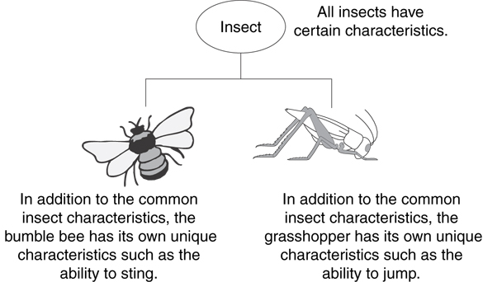
Example: Insect Taxonomy

Slide 5
The "is a" Relationship
Inheritance establishes an "is a" relationship between classes.
A poodle is a dog
A car is a vehicle
A flower is a plant
A football player is an athlete

Slide 6
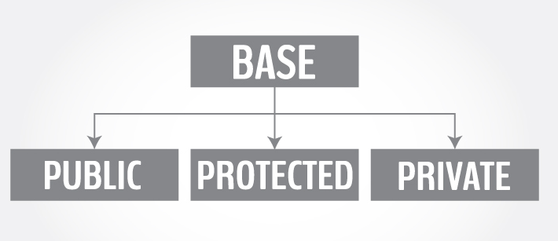
Base Class access control
Derived class can be declared from a base class with different access control, i.e., public inheritance, protected inheritance or private inheritance.

Slide 7
Protected Members and Class Access
Protected member access specification: like private, but accessible by objects of derived class
Class access specification: determines how private, protected, and public members of base class are inherited by the derived class

Slide 8
Class Access Specifiers
public – object of derived class can be treated as object of base class (not vice-versa)
protected – more restrictive than public, but allows derived classes to know details of parents
private – prevents objects of derived class from being treated as objects of base class.

Slide 9
Syntax
1. #include <iostream>
2. using namespace std;
3. class base
4. { .... ... .... };
5. class derived : access_specifier base
6. { .... ... .... };
Either public, protected or private keyword is used in place of access_specifier term used in the syntax code code.

Slide 10
1.class base {
2. public: int x;
3. protected: int y;
4. private: int z; };
5. class publicDerived: public base {
6. // x is public
7. // y is protected
8. // z is not accessible from publicDerived };
class protectedDerived: protected base {
// x is protected
// y is protected
// z is not accessible from protectedDerived };
class privateDerived: private base {
// x is private
// y is private
// z is not accessible from privateDerived }

Slide 11
Observations
base class has three member variables: x, y and z which are public, protected and private member respectively.
publicDerived inherits variables x and y as public and protected. z is not inherited as it is a private member variable of base class.
protectedDerived inherits variables x and y. Both variables become protected. z is not inherited.

Slide 12
Observations (Cont…)
If we derive a class derivedFromProtectedDerived from protectedDerived, variables x and y are also inherited to the derived class.
privateDerived inherits variables x and y. Both variables become private. z is not inherited
If we derive a class derivedFromPrivateDerived from privateDerived, variables x and y are not inherited because they are private variables of privateDerived.

Slide 13
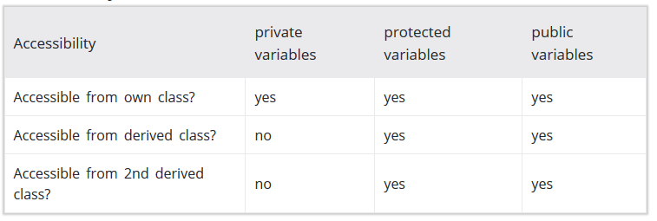
Accessibility in Public Inheritance

Slide 14
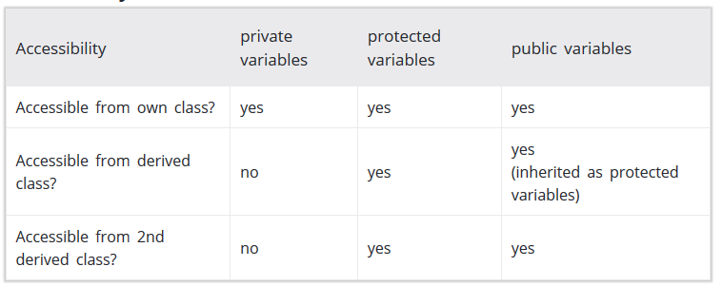
Accessibility in Protected Inheritance

Slide 15
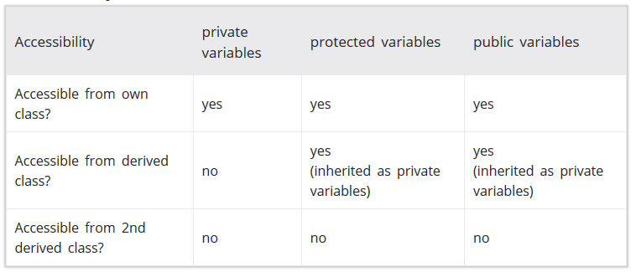
Accessibility in Private Inheritance

Slide 16
Inheritance vs. Access
How inherited base class members
appear in derived class
Base class members
private: x
protected: y
public: z
private
base class
x is inaccessible
private: y
private: z
private: x
protected: y
public: z
protected
base class
x is inaccessible
protected: y
protected: z
private: x
protected: y
public: z
public
base class
x is inaccessible
protected: y
public: z

Slide 17
Inheritance vs. Access
class Grade
class Test : public Grade
private members:
char letter;
float score;
void calcGrade();
public members:
void setScore(float);
float getScore();
char getLetter();
private members:
int numQuestions;
float pointsEach;
int numMissed;
public members:
Test(int, int);
private members:
int numQuestions:
float pointsEach;
int numMissed;
public members:
Test(int, int);
void setScore(float);
float getScore();
char getLetter();
When Test class inherits
from Grade class using
public class access, it looks like this:

Slide 18
Inheritance vs. Access
class Grade
class Test : protected Grade
private members:
char letter;
float score;
void calcGrade();
public members:
void setScore(float);
float getScore();
char getLetter();
private members:
int numQuestions;
float pointsEach;
int numMissed;
public members:
Test(int, int);
private members:
int numQuestions:
float pointsEach;
int numMissed;
public members:
Test(int, int);
protected members:
void setScore(float);
float getScore();
float getLetter();
When Test class inherits
from Grade class using
protected class access, it looks like this:

Slide 19
Inheritance vs. Access
class Grade
class Test : private Grade
private members:
char letter;
float score;
void calcGrade();
public members:
void setScore(float);
float getScore();
char getLetter();
private members:
int numQuestions;
float pointsEach;
int numMissed;
public members:
Test(int, int);
private members:
int numQuestions:
float pointsEach;
int numMissed;
void setScore(float);
float getScore();
float getLetter();
public members:
Test(int, int);
When Test class inherits
from Grade class using
private class access, it looks like this:

Slide 20
What Does a Child Have?
An object of the derived class has:
all members defined in child class
all members declared in parent class
An object of the derived class can use:
all public members defined in child class
all public members defined in parent class

Slide 21
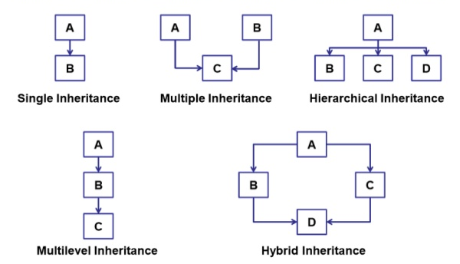
Types of Inheritance

Slide 22
Thanks

Slide 23
Types of Inheritance

Slide 24
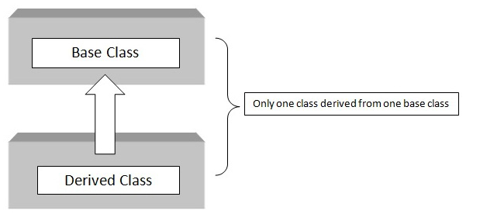
Single Inheritance
Single Inheritance: It is the inheritance hierarchy wherein one derived class inherits from one base class.

Slide 25
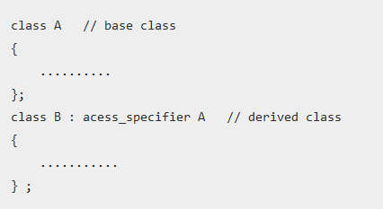
Single Inheritance Syntax

Slide 26
Single Inheritance Example
#include <iostream.h>
using namespace std;
class Shape { Output
protected:
int width;
int height;
public:
void setWidth(int w) {
width = w; }
void setHeight(int h) {
height = h; } } ;
class Rectangle: public Shape {
public:
int getArea() {
return (width * height); } }
int main {
Rectangle Rect;
Rect.setWidth(5);
Rect.setHeight(7);
cout << "Total area: " << Rect.getArea() << endl; // Print the area of the object.
return 0;
}

Slide 27
#include <iostream.h>
using namespace std;
class base {
int i, j;
public:
void set(int a, int b)
{ i=a; j=b; }
void show()
{ cout << i << " " << j << "\n"; }
};
class derived : public base {
int k;
public:
derived(int x) { k=x; }
void showk() { cout << k << "\n"; }
};
int main()
{
derived ob(3);
ob.set(1, 2); // access member of base
ob.show(); // access member of base
ob.showk(); // uses member of derived class
return 0;
}

Slide 28
// This program won't compile.
#include <iostream.h>
using namespace std;
class base {
int i, j;
public:
void set(int a, int b) { i=a; j=b; }
void show() { cout << i << " " << j << "\n";}
};
// Public elements of base are private in derived.
class derived : private base {
int k;
public:
derived(int x) { k=x; }
void showk()
{ cout << k << "\n"; }
};
int main()
{
derived ob(3);
ob.set(1, 2);
// error, can't access set()
ob.show();
// error, can't access show()
return 0;
}

Slide 29
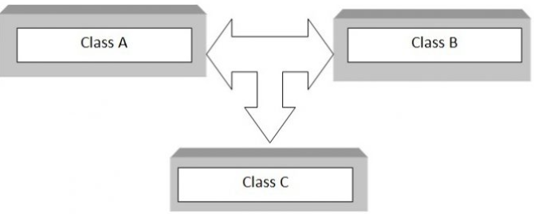
Multiple Inheritance
Multiple Inheritance: It is the inheritance hierarchy wherein one derived class inherits from multiple base class(es).

Slide 30
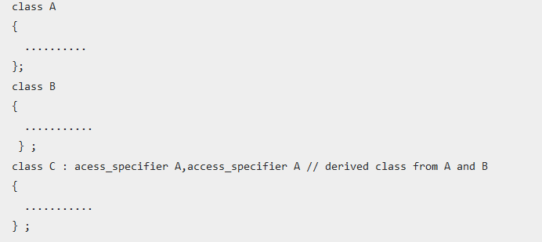
Syntax

Slide 31
Inheriting Multiple Base Classes
#include <iostream>
using namespace std;
class base1 {
protected:
int x;
public:
void showx() { cout << x << "\n"; }
};
class base2 {
protected:
int y;
Public:
void showy() {cout << y << "\n";}
};
// Inherit multiple base classes.
class derived: public base1, public base2 {
public:
void set(int i, int j) { x=i; y=j; }
};
int main()
{
derived ob;
ob.set(10, 20);
// provided by derived
ob.showx(); // from base1
ob.showy(); // from base2
return 0;
}

Slide 32
//EXAMPLE
#include <iostream.h>
using namespace std;
// Base class Shape
class Shape {
public:
void setWidth(int w) {
width = w; }
void setHeight(int h) {
height = h; }
protected:
int width;
int height;
};
// Base class PaintCost
class PaintCost {
public:
int getCost(int area) {
return area * 70;
}};
// Derived class
class Rectangle: public Shape, public PaintCost {
public:
int getArea() {
return (width * height);
} };
int main(void) {
Rectangle Rect;
int area;
Rect.setWidth(5);
Rect.setHeight(7);
area = Rect.getArea();
// Print the total cost of painting
cout << "Total paint cost: $" << Rect.getCost(area) << endl;
return 0; }

Slide 33
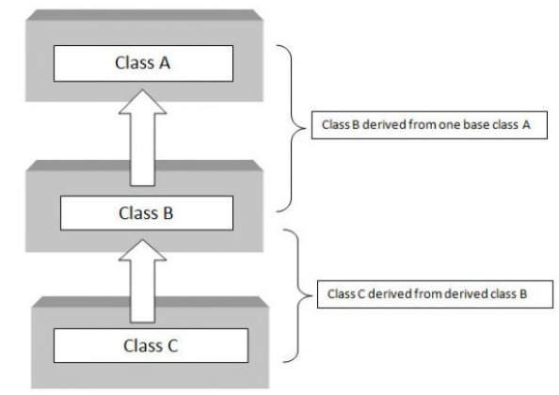
Multilevel Inheritance
Multilevel Inheritance: It is the inheritance hierarchy wherein subclass acts as a base class for other classes.

Slide 34
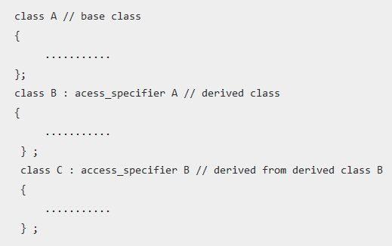
Syntax

Slide 35
Multi-level Inheritance
#include <iostream>
using namespace std;
//Base class
class base {
public:
void display1() {
cout << "\nBase class content."; }
};
//derived class
class derived : public base
{
public:
void display2()
{
cout << "1st derived class content."; } };
//derived2 class
class derived2 : public derived
{ public:
void display3(){
cout << "\n2nd Derived class content.";
} };
int main()
{
derived2 D;
D.display3();
D.display2();
D.display1();
return(0);
}

Slide 36
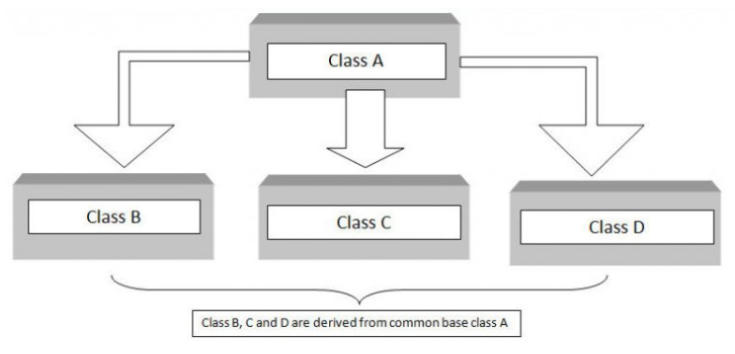
Hierarchical Inheritance
Hierarchical Inheritance: It is the inheritance hierarchy wherein multiple subclasses inherit from one base class.

Slide 37
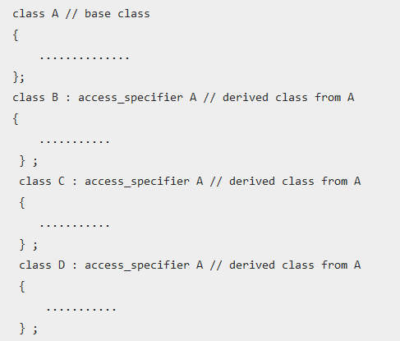
Hierarchical Inheritance

Slide 38
Hierarchical Inheritance
#include <iostream>
#include <string.h>
using namespace std;
//Base Class
class member {
char gender[10];
int age;
public:
void get()
{ cout << "Age: "; cin >> age;
cout << "Gender: "; cin >> gender; }
void disp() {
cout << "Age: " << age << endl; cout << "Gender: " << gender << endl; }
};
//derived from member
class stud : public member
{ char level[20];
public:
void getdata() { member::get();
cout << "Class: ";
cin >> level; }
Continue...

Slide 39
void disp2()
{ member::disp();
cout << "Level: " << level;
} };
//staff class derived from member
class staff : public member
{ float salary;
public:
void getdata() { member::get();
cout << "Salary: Rs.";
cin >> salary; }
void disp3() { member::disp();
cout << "Salary: Rs." << salary << endl;
} };
int main() {
//member M;
staff S;
stud s;
s.getdata();
s.disp();
S.getdata();
S.disp();
return(0); }

Slide 40
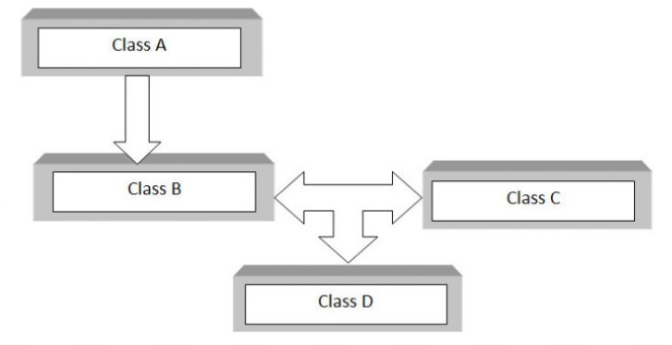
Hybrid Inheritance
Hybrid Inheritance: The inheritance hierarchy that reflects any legal combination of other four types of inheritance.

Slide 41
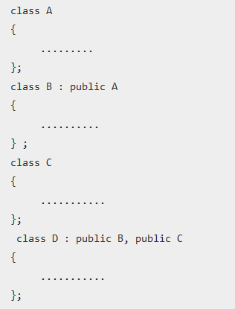
Syntax

Slide 42
#include <iostream>
using namespace std;
class A {
public: int x;
};
class B : public A {
public: B() //constructor to initialize x in base class A
{ x = 10; }
};
class C {
public: int y; C() //constructor to initialize y { y = 4; }
};
class D : public B, public C
//D is derived from class B and class C
{ public:
void sum()
{ cout << "Sum= " << x + y; }
};
int main()
{ D obj1; //object of derived class D
obj1.sum();
return 0; Output
}

Slide 43
Thanks

Slide 44
Constructors and Destructors in Base and Derived Classes
Derived classes can have their own constructors and destructors.
When an object of a derived class is created, the base class’s constructor is executed first, followed by the derived class’s constructor.
When an object of a derived class is destroyed, its destructor is called first, then that of the base class.

Slide 45
//EXAMPLE
#include<iostream>
Using namespace std;
//base class
class base {
public:
base()
{ cout << "Constructing base\n"; }
~base()
{ cout << "Destructing base\n"; }
};
//derived class
class derived: public base {
public:
derived()
{
cout << "Constructing derived\n"; }
~derived()
{ cout << "Destructing derived\n"; }
};
int main()
{
derived ob;
// do nothing but construct and destruct ob
return 0;
}
Program Output
Constructing base
Constructing derived
Destructing derived
Destructing base

Slide 46
Constructors and Destructors with Multiple Base Classes
Constructors are called in order of derivation, left to right, as specified in derived's inheritance list.
Destructors are called in reverse order, right to left.

Slide 47
//MULTI-LEVEL
#include <iostream>
using namespace std;
class base {
public:
base()
{ cout << "Constructing base\n"; }
~base() { cout << "Destructing base\n"; }
};
class derived1 : public base {
public:
derived1() { cout << "Constructing derived1\n"; }
~derived1() { cout << "Destructing derived1\n"; }
};
class derived2: public derived1 {
public:
derived2() { cout << "Constructing derived2\n"; }
~derived2() { cout << "Destructing derived2\n"; }
};
int main()
{
derived2 ob;
// construct and destruct ob
return 0;
}
Program Output:
Constructing base
Constructing derived1
Constructing derived2
Destructing derived2
Destructing derived1
Destructing base

Slide 48
//MULTIPLE BASE CASES
#include <iostream>
using namespace std;
class base1 {
public:
base1() { cout << "Constructing base1\n"; }
~base1() { cout << "Destructing base1\n"; }
};
class base2 {
public:
base2() { cout << "Constructing base2\n"; }
~base2() { cout << "Destructing base2\n"; }
};
class derived: public base1, public base2 {
public:
derived() { cout << "Constructing derived\n"; }
~derived() { cout << "Destructing derived\n"; }
};
int main()
{
derived ob;
// construct and destruct ob
return 0;
}
Program Output:
Constructing base1
Constructing base2
Constructing derived
Destructing derived
Destructing base2
Destructing base1

Slide 49
Passing Arguments to Base Class Constructor
derived-constructor(arg-list) : base1(arg-list),
base2(arg-list),
// ...
baseN(arg-list)
{
// body of derived constructor
}

Slide 50
Order of Constructor Call
Base class constructors are always called in the derived class constructors.
Whenever you create derived class object, first the base class default constructor is executed and then the derived class's constructor finishes execution.

Slide 51
//EXAMPLE
#include <iostream>
using namespace std;
class base {
protected:
int i;
public:
base(int x)
{ i=x; cout << "Constructing base\n"; }
~base() { cout << "Destructing base\n"; }
};
class derived: public base {
int j;
public:
// derived uses x; y is passed along to base.
derived(int x, int y): base(y)
{ j=x;
cout << "Constructing derived\n"; }
~derived() { cout << "Destructing derived\n"; }
void show() { cout << i << " " << j << "\n"; }
};
int main()
{
derived ob(3, 4);
ob.show(); // displays 4 3
return 0;
}

Slide 52
//MULTIPLE BASE CASES
#include <iostream>
using namespace std;
class base1 {
protected: int i;
public:
base1(int x) { i=x; cout << "Constructing base1\n"; }
~base1() { cout << "Destructing base1\n"; }};
class base2 {
protected: int k;
public:
base2(int x) { k=x; cout << "Constructing base2\n"; }
~base2() { cout << "Destructing base1\n"; } };
class derived: public base1, public base2 {
int j;
public:
derived(int x, int y, int z): base1(y), base2(z)
{ j=x; cout << "Constructing derived\n"; }
~derived() { cout << "Destructing derived\n"; }
void show() { cout << i << " " << j << " " << k << "\n"; }
};
int main()
{ derived ob(3, 4, 5);
ob.show(); // displays 4 3 5
return 0; }

Slide 53
Here’s what actually happens when base is instantiated:
Memory for base is set aside
The appropriate Base constructor is called
The initialization list initializes variables
The body of the constructor executes
Control is returned to the caller

Slide 54
Here’s what actually happens when derived is instantiated:
Memory for derived is set aside (enough for both the Base and Derived portions)
The appropriate Derived constructor is called
The Base object is constructed first using the appropriate Base constructor. If no base constructor is specified, the default constructor will be used.
The initialization list initializes variables
The body of the constructor executes
Control is returned to the caller

Slide 55
Points to note
It is important to understand that arguments to a base-class constructor are passed via arguments to the derived class' constructor.
Even if a derived class‘ constructor does not use any arguments, it will still need to declare one if the base class requires it.
In this situation, the arguments passed to the derived class are simply passed along to the base.

Slide 56
Why is Base class Constructor called inside Derived class?
Constructors have a special job of initializing the object properly.
A Derived class constructor has access only to its own class members, but a Derived class object also have inherited property of Base class, and only base class constructor can properly initialize base class members.
Hence all the constructors are called, else object wouldn't be constructed properly.

Slide 57
// This program contains an error and will not compile.
#include <iostream>
using namespace std;
class base {
public: int i; };
class derived1 : public base {
public: int j; };
class derived2 : public base {
public: int k; };
class derived3 : public derived1, public derived2 {
public: int sum; };
int main() {
derived3 ob;
ob.i = 10; // this is ambiguous, which i???
ob.j = 20;
ob.k = 30;
// i ambiguous here, too
ob.sum = ob.i + ob.j + ob.k;
// also ambiguous, which i?
cout << ob.i << " ";
cout << ob.j << " " << ob.k ;
cout << ob.sum;
return 0;
}

Slide 58
Discussion
which ‘i’ is being referred to, the one in derived1 or the one in derived2?
Because there are two copies of base present in object ob, there are two ob.is! As you can see, the statement is inherently ambiguous.
There are two ways to remedy the preceding program.
The first is to apply the scope resolution operator to i and manually select one i. Example (on next slide).

Slide 59
// This program uses explicit scope resolution to select i.
#include <iostream>
using namespace std;
class base { public: int i; };
// derived1 inherits base.
class derived1 : public base {
public: int j; };
// derived2 inherits base.
class derived2 : public base {
public: int k; };
class derived3 : public derived1, public derived2 {
public: int sum; };
int main()
{
derived3 ob;
ob.derived1::i = 10; // scope resolved, use derived1's i
ob.j = 20;
ob.k = 30;
// scope resolved
ob.sum = ob.derived1::i + ob.j + ob.k;
// also resolved here
cout << ob.derived1::i << " ";
cout << ob.j << " " << ob.k << " ";
cout << ob.sum;
return 0; }

Slide 60
Discussion
As you can see, because the :: was applied, the program has manually selected derived1's version of base.
What if only one copy of base is actually required? Is there some way to prevent two copies from being included in derived3? This solution is achieved using virtual base classes.

Slide 61
When two or more objects are derived from a common base class, you can prevent multiple copies of the base class from being present in an object derived from those objects by declaring the base class as virtual when it is inherited.
You accomplish this by preceding the base class' name with the keyword virtual when it is inherited.
For example, here is another version of the example program in which derived3 contains only one copy of base:
Example Program Next Slide

Slide 62
// This program uses virtual base classes.
#include <iostream>
using namespace std;
class base { public: int i; };
// derived1 inherits base as virtual.
class derived1 : virtual public base {
public: int j; };
// derived2 inherits base as virtual.
class derived2 : virtual public base {
public: int k; };
class derived3 : public derived1, public derived2
{ public: int sum; };
int main()
{
derived3 ob;
ob.i = 10; // now unambiguous
ob.j = 20;
ob.k = 30;
// unambiguous
ob.sum = ob.i + ob.j + ob.k;
// unambiguous
cout << ob.i << " ";
cout << ob.j << " " << ob.k << " ";
cout << ob.sum;
return 0;
}

Slide 63
Discussion
As you can see, the keyword virtual precedes the rest of the inherited class‘specification.
Now that both derived1 and derived2 have inherited base as virtual, any multiple inheritance involving them will cause only one copy of base to be present.
Therefore, in derived3, there is only one copy of base and ob.i = 10 is perfectly valid and unambiguous.

Slide 64
Inheritance and Static Functions
They are inherited into the derived class.
If you redefine a static member function in derived class, all the other overloaded functions in base class are hidden.
Static Member functions can never be virtual.

Slide 65
Abstract Class
An abstract class is designed to act as base class. It is a design concept in program development and provides a base upon which other classes may be built.
Abstract Class is a class which contains atleast one Pure Virtual function in it. Abstract classes are used to provide an Interface for its sub classes. Classes inheriting an Abstract Class must provide definition to the pure virtual function, otherwise they will also become abstract class.

Slide 66
Characteristics of Abstract Class
Abstract class cannot be instantiated, but pointers and references of Abstract class type can be created.
Abstract class can have normal functions and variables along with a pure virtual function.
Classes inheriting an Abstract Class must implement all pure virtual functions, or else they will become Abstract too.

Slide 67
Pure Virtual Functions
Pure virtual Functions are virtual functions with no definition.
They start with virtual keyword and ends with = 0.
Syntax for a pure virtual function,
virtual void fun() = 0;

Slide 68
//Abstract base class
class Base {
public:
virtual void show() = 0; };
class Derived:public Base {
public:
void show()
{
cout << "Implementation of Virtual Function in Derived class";
}
};
int main()
{
//Base obj; (Compile Time Error)
Base *b;
Derived d;
b = &d;
b->show();
return 0;
}

Slide 69
Note:
Pure Virtual functions can be given a small definition in the Abstract class, which you want all the derived classes to have. Still you cannot create object of Abstract class.
Also, the Pure Virtual function must be defined outside the class definition. If you will define it inside the class definition, complier will give an error. Inline pure virtual definition is Illegal.

Slide 70
Thanks

